Slide 1



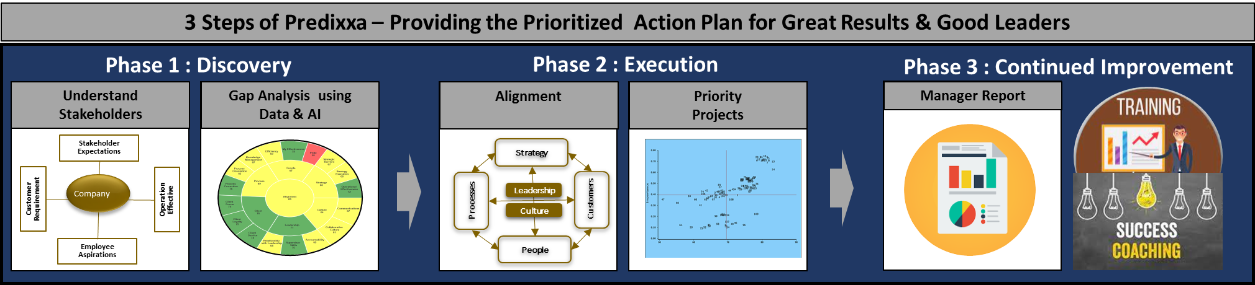

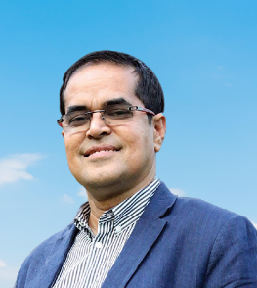
PROVIDING CEOs /COOs WITH ACTIONABLE INSIGHT FOR RAPID DIGITAL TRANSFORMATION Friday, 17 June 2022 l 09.30 – 11.00 AM (Bangladesh Time) l Zoom Platform
Who Should Attend:
CEOs, C Level, Directors,
HR Managers
Speakers :
Predixxa is a leading methodology that tells what is needed for a rapidly thinking company. It is based on 35 years of empirical research at Harvard.
Stan Labovitz
CEO & Founder SURVEY TELLIGENCE
BSBA, JD, COAS
DR. Naresh Makhijani
President Director OTI
WEBINAR AGENDA :
Challenges in Managing Company in New Normal
Understanding the Shareholder, Customer, and Employee Expectations
Discover the Key Actions Needed from Data Analysis
Transforming the Company with Key Actions for Better Results
Rapid Implementation Methodology
PhD, CMA, MBA, PGDMSM, BSc
MSID, CMC, MPM, CIE, B Coach,
FAAPM, EBAS, ICP- BAS, EA*, CBA*
MIT SLOAN IDEAS Fellow,
HARVARD Executive Education
BENEFITS :
Understand the Methodology for Transformation
See the Tools for Transformation
Understand how to Turn Managers into Leaders
Register via SMS or email
+8801711561861 Quazi.Ahmed@FutureLeadersGroup.com
Quazi M. Ahmed
Founder & President, BOLD Founder & CEO, FutureLeaders

Slide 2
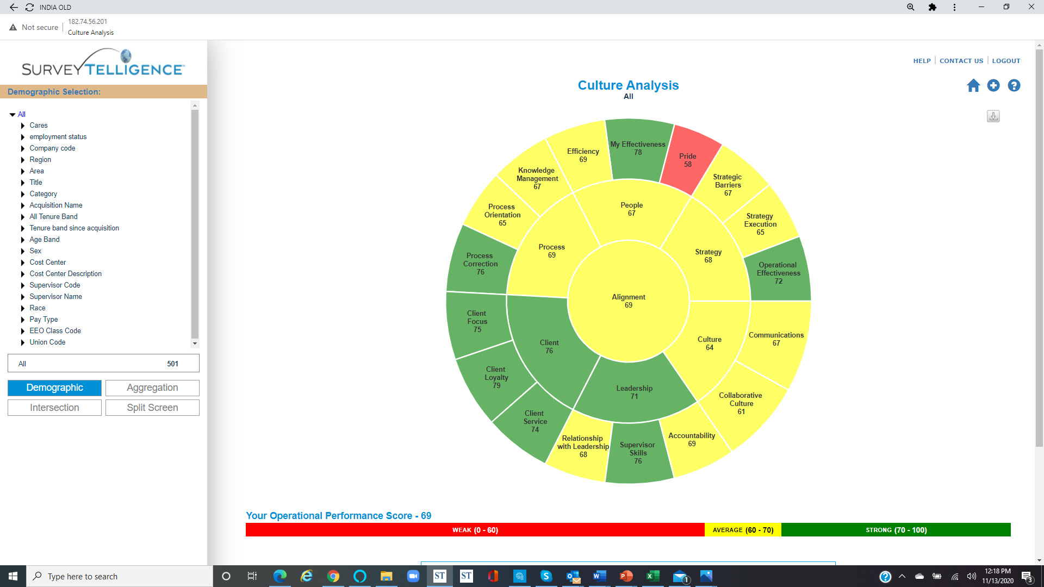
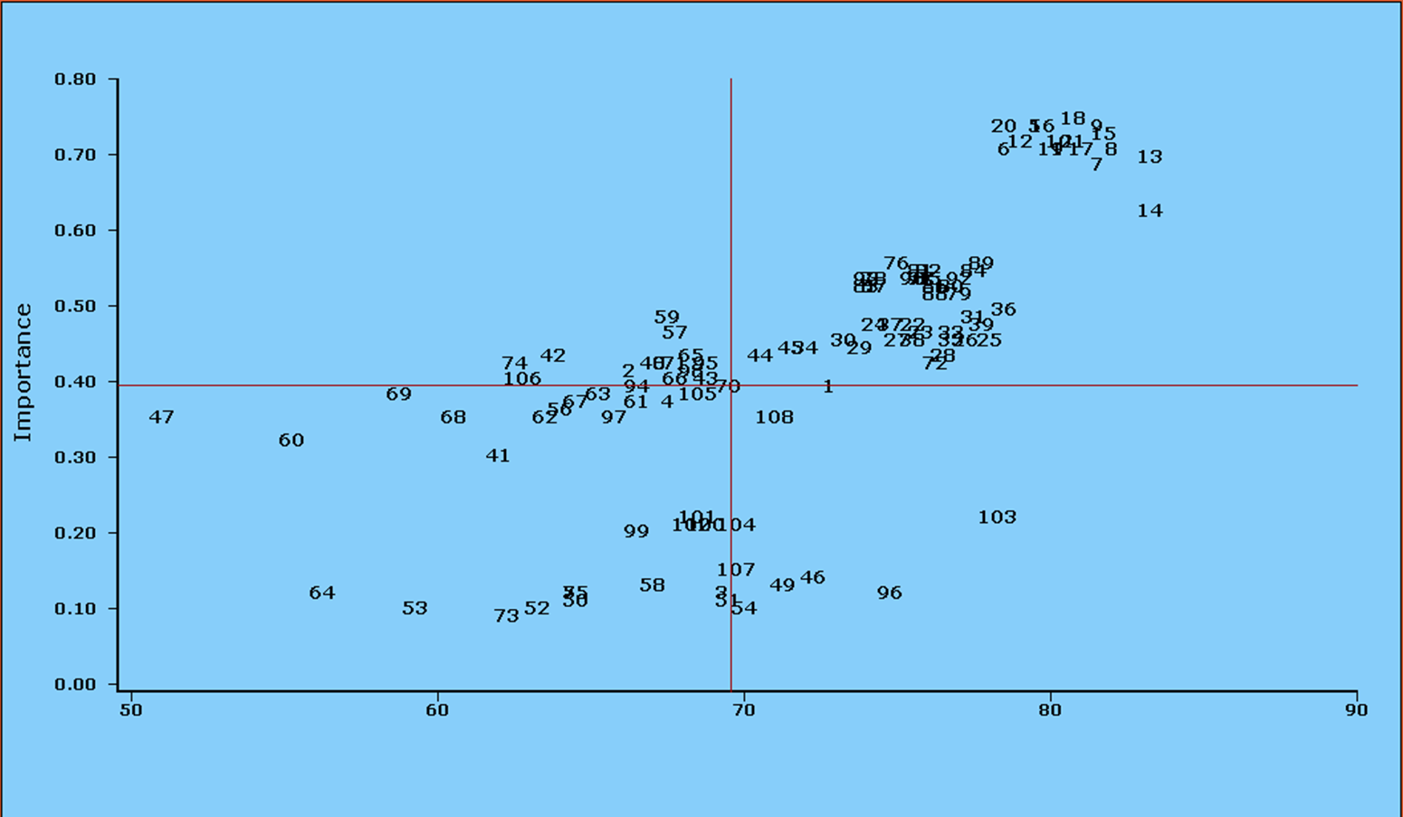




5 Steps of Predixxa – Providing the Prioritized Action Plan for Great Results & Good Leaders
1
2
3
4
5
Understand Stakeholders
Gap Analysis using Data & AI
Alignment
Priority
Projects
Company
Growth
Stakeholder Expectations
Strategy
Customer Requirement
Company
Operation
Effective
Processes
Leadership
Customers
Culture
Employee Aspirations
People
3 Steps of Predixxa – Providing the Prioritized Action Plan for Great Results & Good Leaders
Phase 1 : Discovery
Phase 2 : Execution
Phase 2 : Execution
Phase 3 : Continued Improvement
Understand Stakeholders
Gap Analysis using Data & AI
Alignment
Priority
Projects
Manager Report
Stakeholder Expectations
Strategy
Customer Requirement
Company
Operation
Effective
Processes
Leadership
Customers
Culture
Employee Aspirations
People

